Slide 1
MUST KNOW
Full-time degree students
Akvilė Kaučikaitė, International Students Manager

Slide 2
10.00 EUR (can be paid at the place of service).

Slide 3
•
•
•
confirmation of studies/acceptance letter from University;
minimum amount is 157 EUR for
one month (1884 EUR per year).
•

Slide 4
the Migration department to collect the document.

Slide 5
•
•
If you are NON-EU citizen and came to Lithuania on visa-free regime, you can legally stay in Lithuania for 90 days while applying for Temporary Residence Permit in Lithuania.
If you are NON-EU citizen and came to Lithuania with the TRP, it is issued for two years or until estimated graduation date. You can extend the validity of your TRP by applying through MIGRIS system.

Slide 6
Application deadlines
General order (paying 80 EUR for the application)
No later than 2 months before current TRP expires
Urgent order (paying 320 EUR for the application)
No later than 1 month before TRP expires
Decision on the issue/renewal of temporary residence permit is taken:
General order – within 2 months
Urgent order – within 1 month

Slide 7
Application procedure (I)
•
•
•
•
•
Valid for 5 months.

Slide 8
Application procedure (II)
•
•
•
Bank statement (no less than 5544 EUR). This must be presented in
•

Slide 9
Application procedure (III)
•
•
•

Slide 10
Application procedure (IV)
*With the TRP you are allowed to work full time in Lithuania

Slide 11
IMPORTANT
You must declare your place of residence within 1 month from arrival.
First step – please contact the dormitory group (dormitory@ktu.lt) regarding the certificate of living place. It’s a document stating that you live in the dormitory.
Second step - after you receive a certificate of living place, you are also required to declare your address at the Municipality. For KTU dormitory residence – please contact the Gričiupio Municipality (address: Gričiupio g. 11, Kaunas) via phone no. 8 37 45 50 17 and book an appointment. During the appointment, you will give them the certificate of living place issued by dormitories office. Municipality will provide you the declaration of living place. This declaration you will have to provide to the Migration department.

Slide 12
ANOTHER IMPORTANT INFORMATION
To get academic certificates, you can order them in AIS system. If you need:
Confirmation of studies/Transcript of records – search option „Certificates ordering“, then choose option: „for academic status“.
Mediation letter – search option „Certificates ordering“, then choose option: „for legal status“.

Slide 13
Please note:
If you decide to take the academic leave/suspend or terminate your studies, your TRP is being cancelled within two weeks.

Slide 14
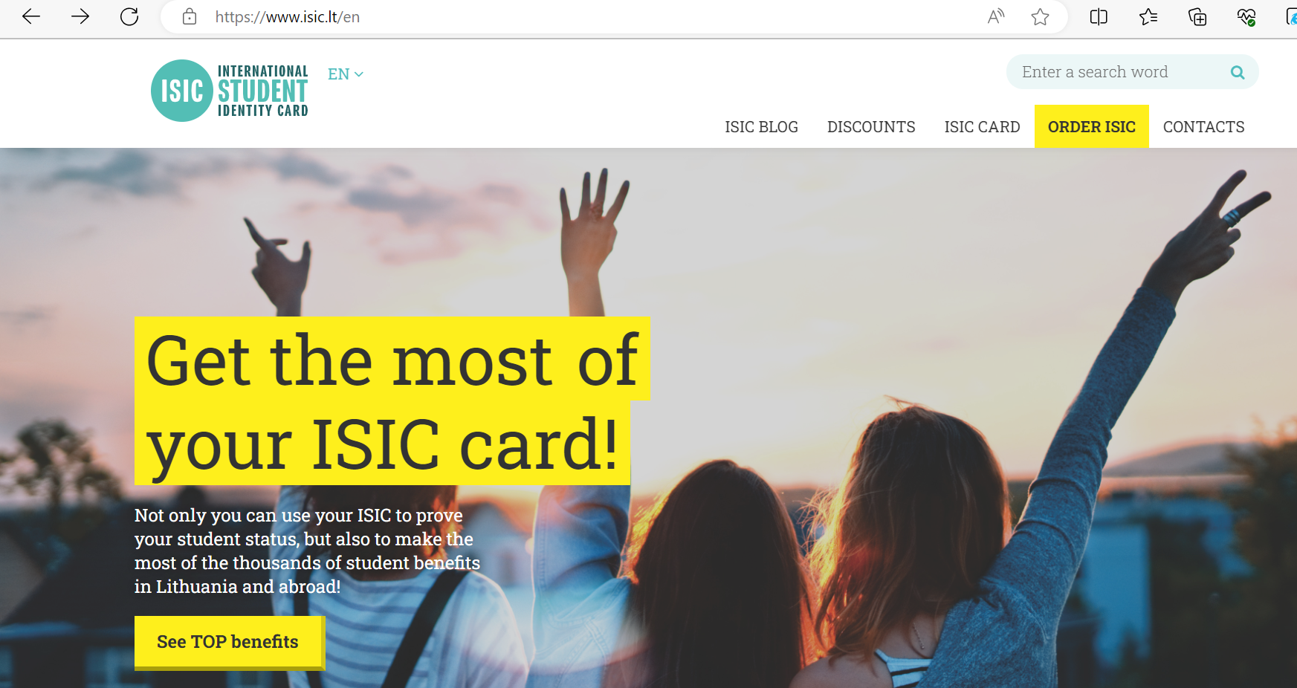
ISIC card
www.isic.lt/en - ORDER ISIC

Slide 15
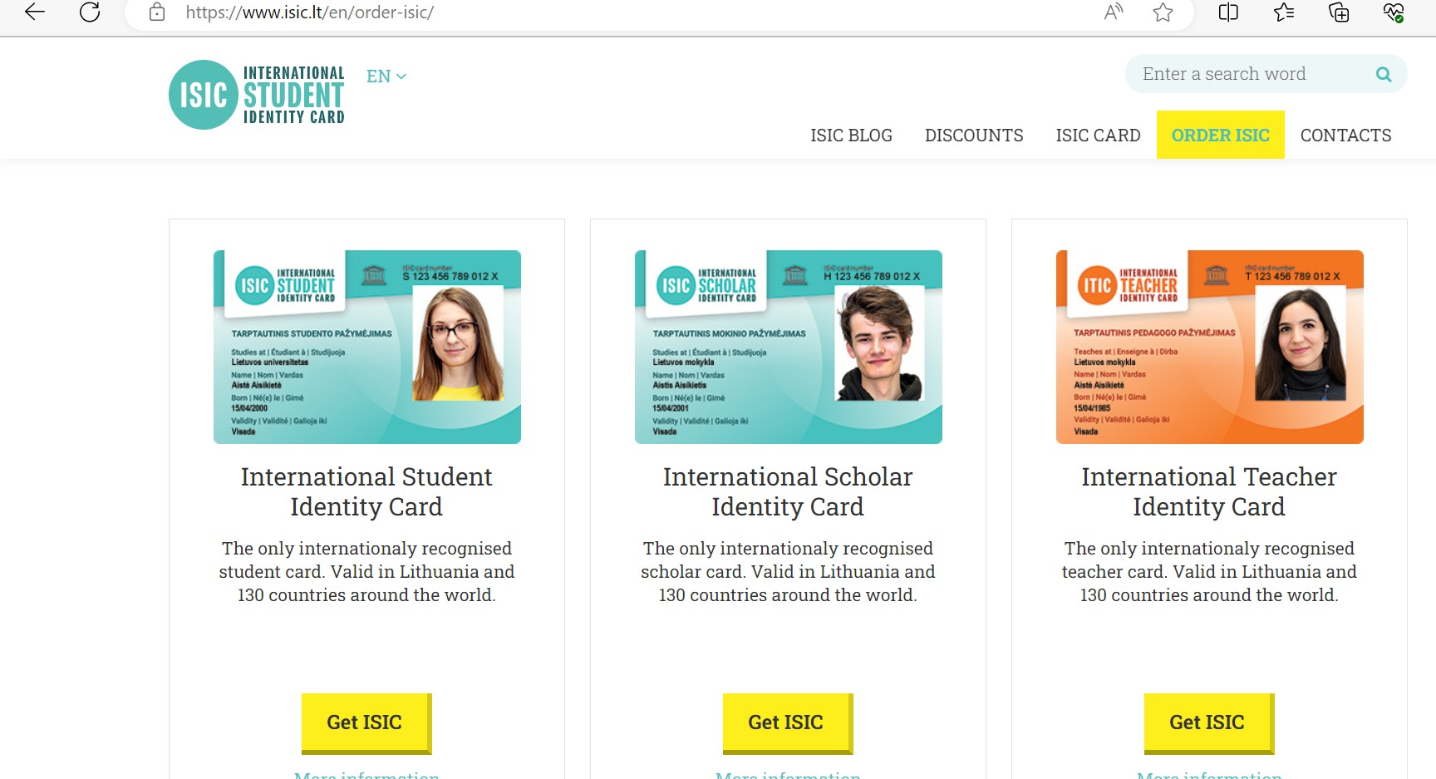
2) International student identity card

Slide 16
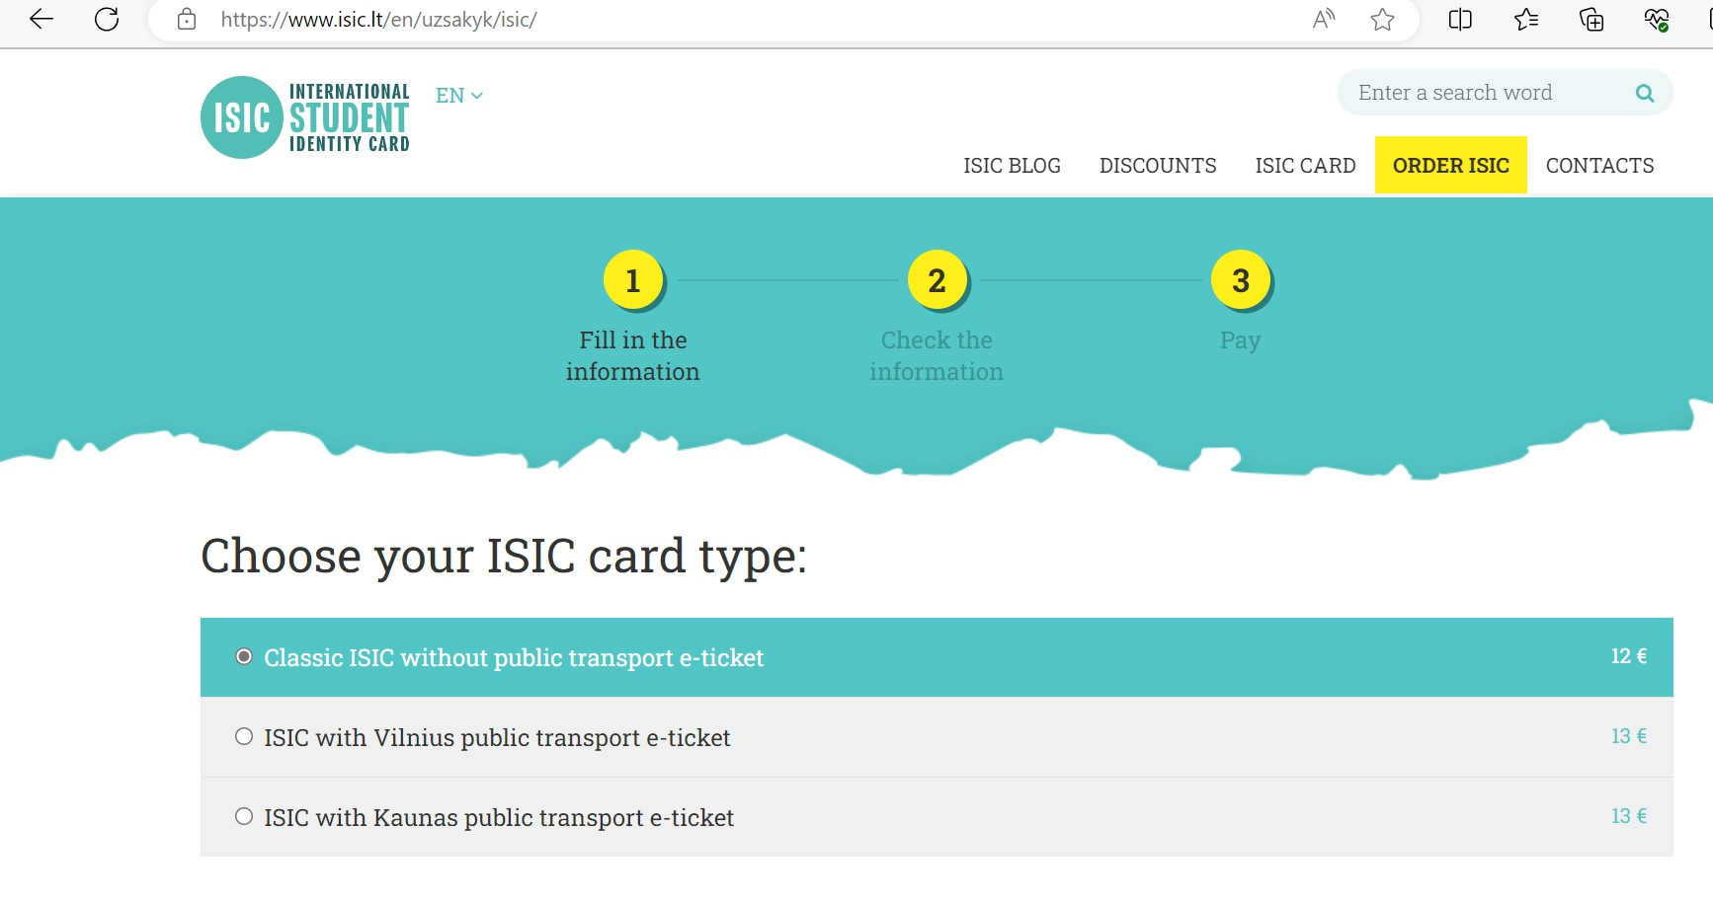
3) Fill in the information, Check the information, Pay

Slide 17
Akvilė Kaučikaitė

