Slide 1
Welcome to Lithuania, Kaunas and KTU
International Relations Department
Audronė Račkauskienė
Head of International Studies Office

Slide 2
THE GAME No1
How do you say “HELLO”
in Lithuanian language?

Slide 3
LABAS
International Relations Department

Slide 4
THE GAME No2
NAME THY NEIGHBOR

Slide 5
1
THE COUNTRY
International Relations Department

Slide 6
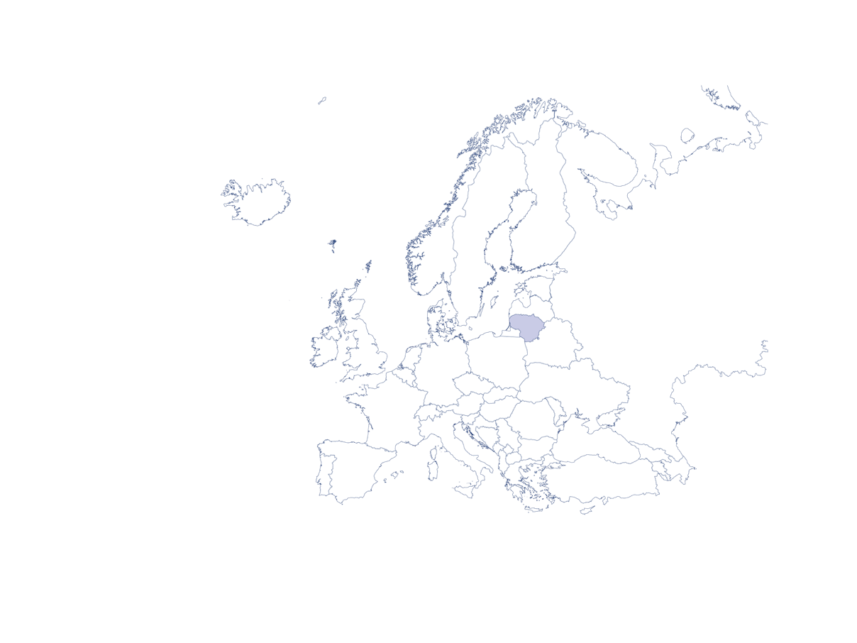
Lithuania – a Baltic state in Northern Europe
65 286 km
area
2.8 million
population
Lithuanian
language
Vilnius
capital city
Euro
currency
EU, NATO, WTO, Schengen Area
member

Slide 7

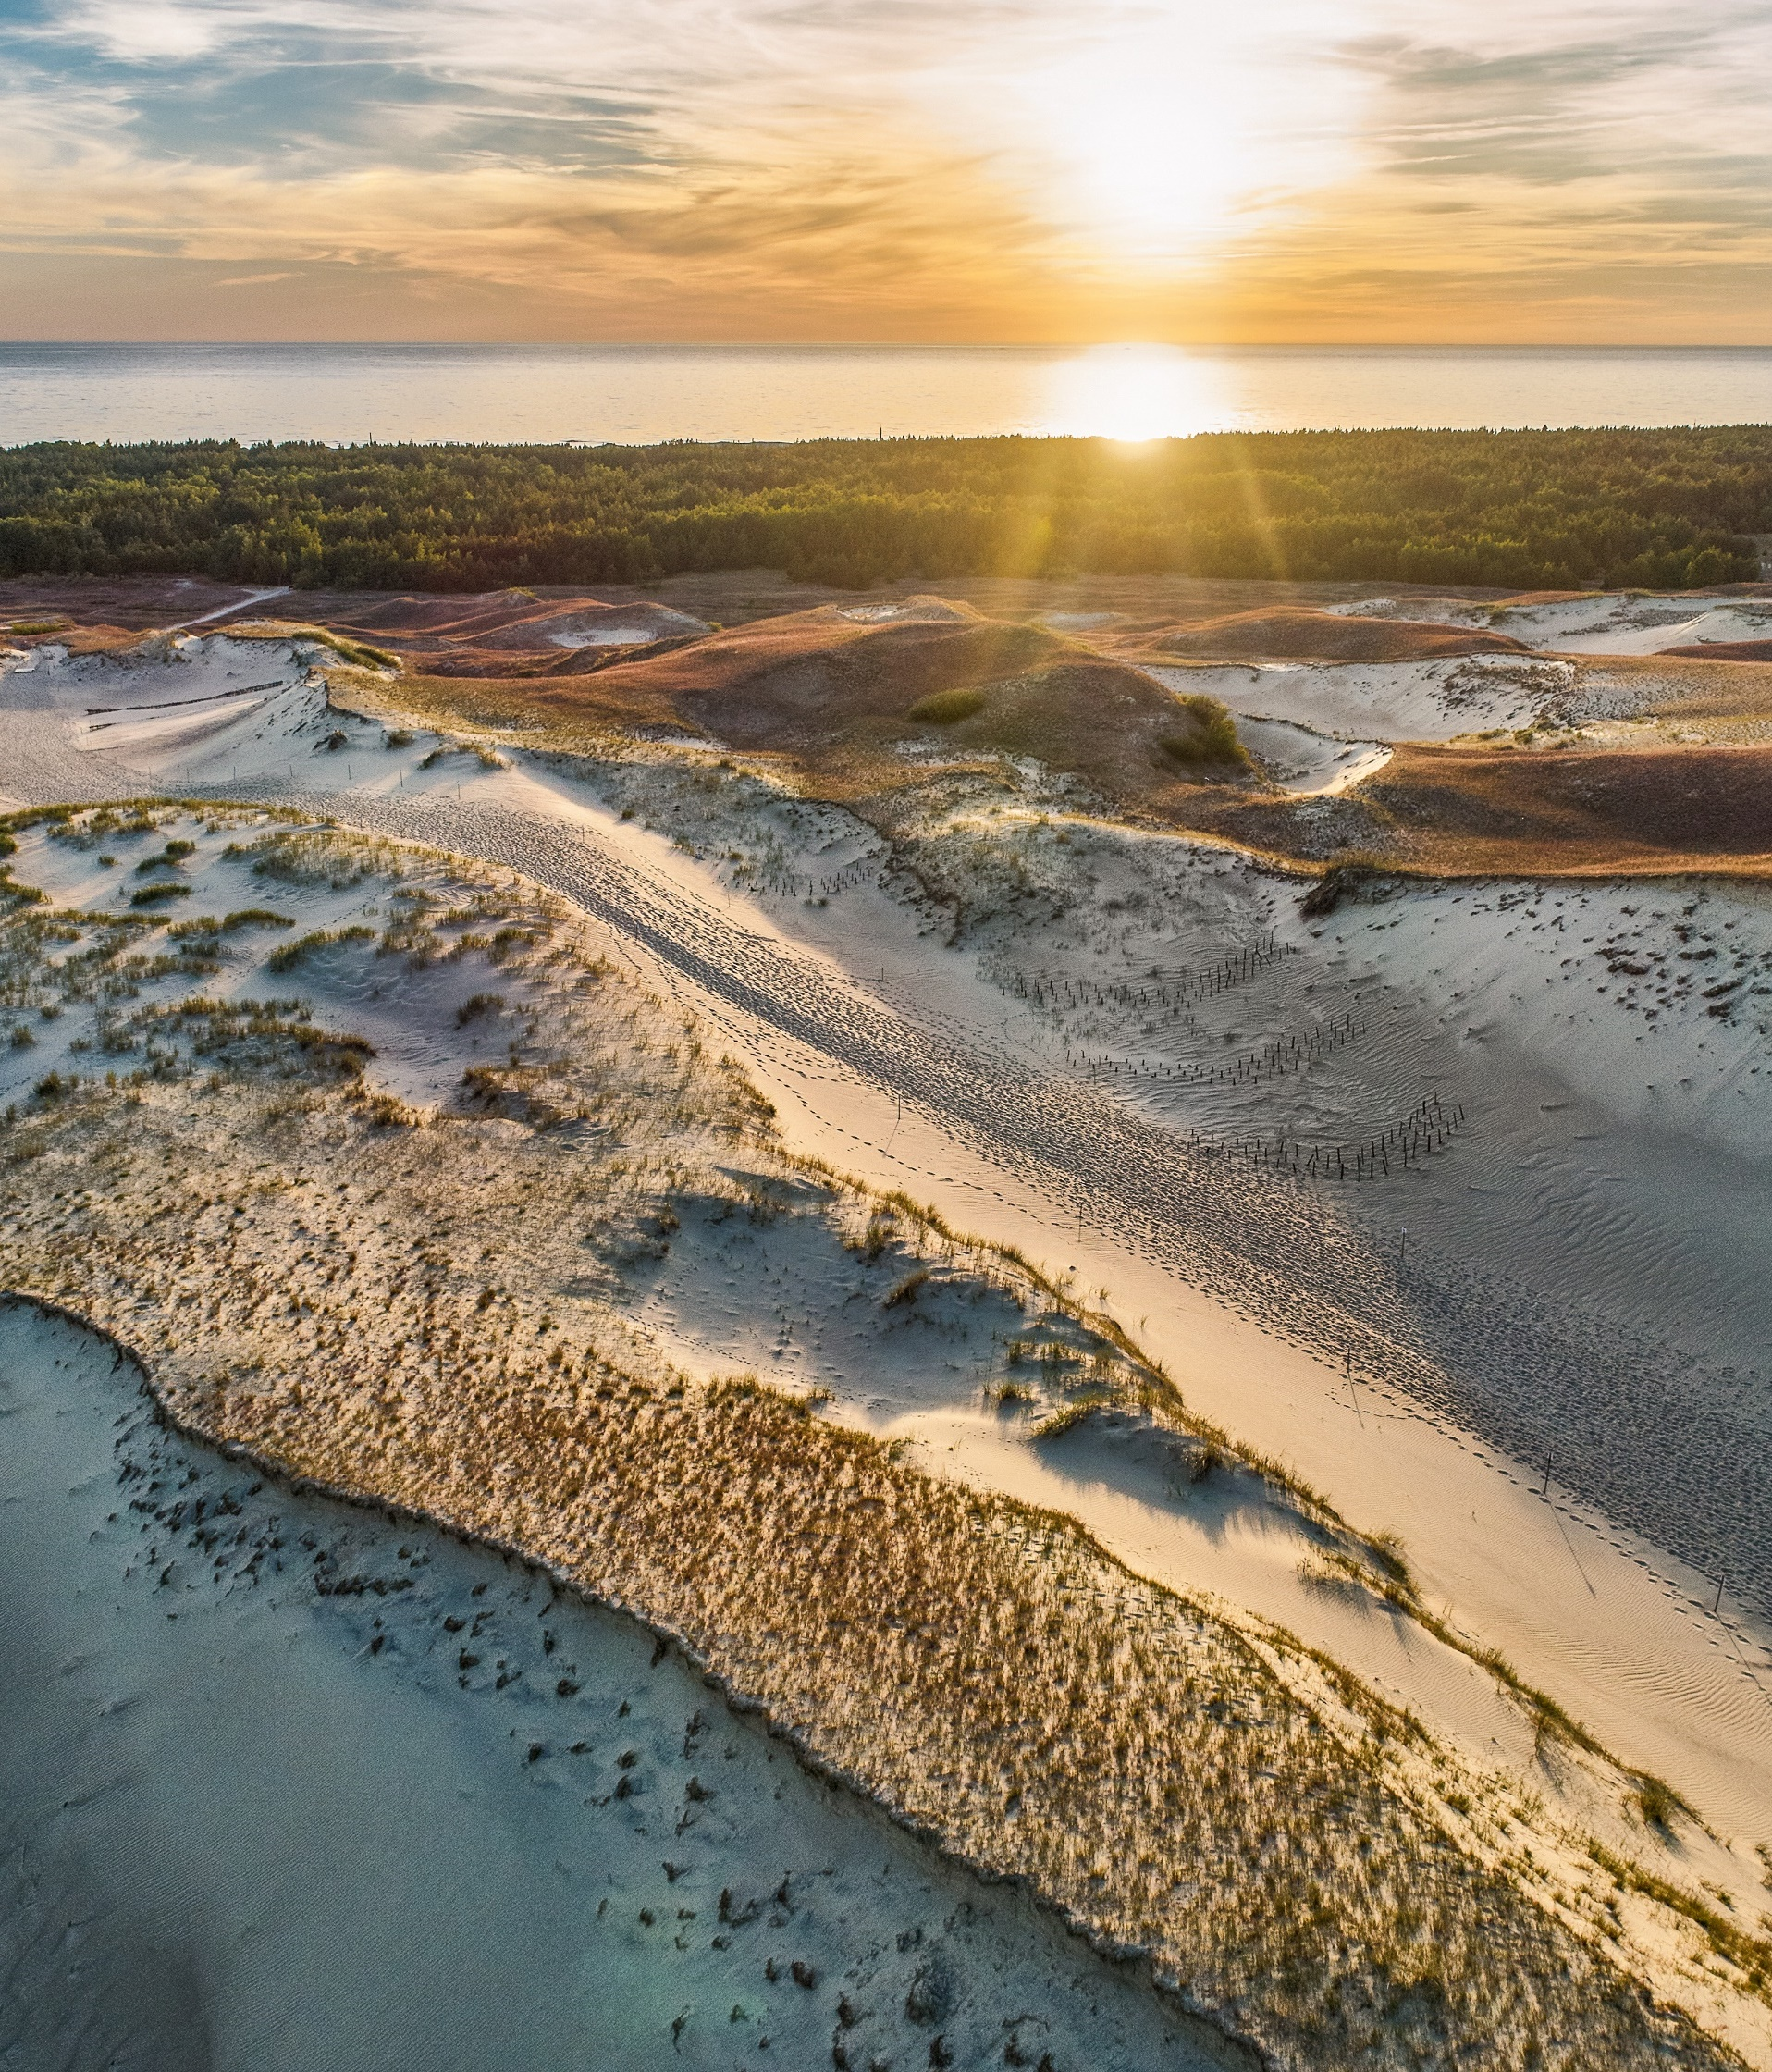
Lithuania: Northern European country on the Baltic sea
Geography
Area 65.286 km²
Population 2.8 million
Marius Jovaiša | www.lithuania.lt
Notes:
What makes Lithuania special is not simply that it marks the compass point where Northern, Eastern, and Western Europe converge.
Being open for trade and cooperation with any country, we nevertheless stand firm with the world on the issues of human rights, freedom and the rule of law. Dismissing these cannot be ‘compensated’ with pragmatic arguments.

Slide 8

Join our booming ecosystems of fintech, life sciences, lasers, plus one of the most vibrant startup ecosystems in Europe
Fauxels | Pexels.com
Notes:
Global solutions in financial technologies.
If in the not-too-distant past Lithuania was known to the world mainly as a basketball country, today it is increasingly called the fintech capital of Europe. The change in Europe’s fintech map has been fast but not accidental. The continuing common efforts of government institutions and the Bank of Lithuania are one key factor in this success. Lithuania ranks 1st in the EU, with a total of 147 licensed fintechs, when it comes to licensed entities (payment institution, electronic money institution and special banking license holders). Second ranking France has 90 licensed entities, Germany – 86, and Netherlands have 84.
In 2021, there were 265 fintech startups operating in Lithuania, to compare with 117 in 2017. Many of the companies chose Lithuania for its favourable regulation, excellent infrastructure and talented specialists.
Focus on life sciences.
Lithuania has set an ambitious goal to become, by 2030, a life sciences trendsetter in the region, with the sector generating 5% of GDP. Boosted by world-leading biotechnology research and strong educational institutions that supply businesses with top-notch talent, the sector is accelerating faster than almost anywhere else in Europe. Growing by a record 87% in 2020, Lithuania’s robust life sciences ecosystem, which includes both established players and up-and-coming startups, contributes an impressive 2.5% to Lithuania‘s GDP, which is about 6 times more than the EU average.
Vilnius offers everything for the life sciences to thrive. The capital has a world-class life sciences centre equipped with all the infrastructure needed for research.
In 2020, the Life Sciences Centre of Vilnius University established a European Molecular Biology Laboratory (EMBL) Partnership Institute, which is hoped to attract world’s talented researchers in genome editing.
Lithuanian lasers are helping solve health and science challenges worldwide.
Lithuania can rightly call itself a laser country. Its special laser expertise is helping find solutions for medicine, science and industry all over the world. Lithuania’s laser industry currently holds more than 50% of the global scientific ultrashort-pulse market, and Lithuania-made lasers can now be found on almost every continent. They are used by NASA, CERN and world-famous companies like IBM, Hitachi, Toyota and Mitsubishi.
Lithuanian lasers and laser systems have also found application in 90 of the world's top 100 universities.
In 2019, the Lithuania-made SYLOS laser system—one of the most powerful laser systems in the world—was inaugurated at an important laser research centre in Hungary.
Besides its scientific institutions, Lithuania now boasts over 50 homegrown laser companies. As makers of specialised devices that export over 95 percent of what they produce, Lithuanian laser companies do not compete with each other, and in some niches have no competitors anywhere in the world.
Lithuanian lasers are exported to more than 80 countries.
Startups.
Over a thousand startups operating in Lithuania unanimously state that the country is a great place to try things out and experiment.
The thriving ecosystem has led to record investments that innovative Lithuanian companies have attracted in recent years, and it also facilitated the emergence of the first unicorn Vinted in 2019. On 7 April, Lithuania welcomed its second unicorn, a cyber security tech firm, Nord Security, which has raised $100 million from investors at a $1.6 billion valuation. The company is best known for its product, NordVPN, which is one of the most popular VPNs in the world.
StartupBlink (2021) places Lithuania 16th globally among 202 countries by the strength of startup ecosystem. Startup companies name three things as most impressive about Lithuania: the conditions for business financing, the level of public engagement, and state institutions’ attention towards nurturing of the ecosystem.
Lithuania outperfoms Scandinavian countries by the governmental financial support for startups per capita. Startups receive support from other public organisations such as Enterprise Lithuania, Go Vilnius, and the Bank of Lithuania, on visas, business ecosystem, and legal matters.
The brands of Lithuanian startups are known all over the world. It would hardly be possible to do without Trafi, Vinted, Nord Security, Kilo Health or other brands in our daily life.
These brands and big international teams share the desire to find solutions to help the world address the problems of mobility and consumption.

Slide 9
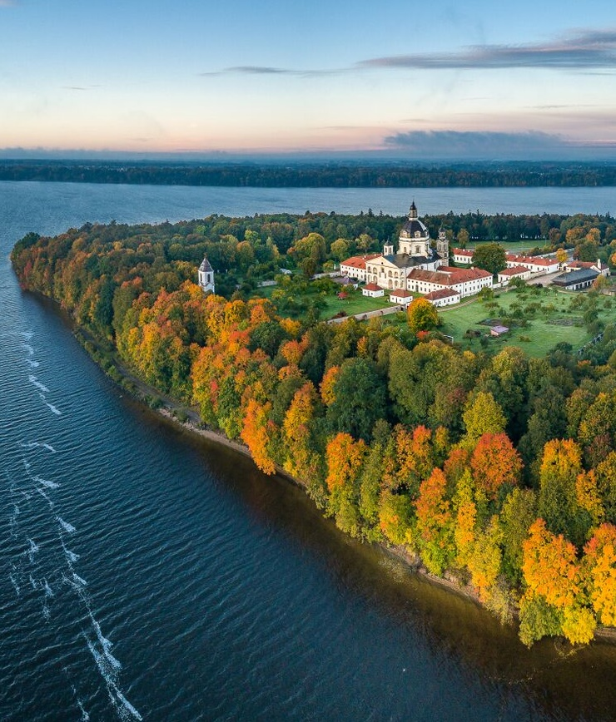
Lithuania is fast becoming the go-to destination for global names like HBO and Netflix
Pažaislis - best European filming location 2020
Andrius Aleksandravičius | www.lithuania.lt
Notes:
Work with global filmmakers.
Lithuania is popular among international producers of TV series and movies. Even without a film studio, the country is putting its name on the map as a very attractive place for the international film industry.
Among the reasons foreign producers give for choosing Lithuania are tax advantages, local production companies’ professionalism, the picturesque landscape, and the possibilities cities offer to adapt to their scripts. Lithuania’s portfolio speaks for itself: Chernobyl, Stranger Things and War and Peace were all filmed here.
Netflix started filming in Lithuania in 2015.
In total 50.7 mln Euro were attracted into the filmmaking industry, throughout the whole period international filmmakers have spent more than 140 mln Euro in Lithuania, a quarter of these expenses were received in 2021 alone;
In 2021 19 foreign projects were working in Lithuania. Of those, as many as 10 – Scandinavian region film projects – 5 Swedish and 5 Norwegian. Another 3 projects were filmed by the filmmakers from the United Kingdom, as well as other projects with filmmakers from Germany, Estonia, Poland, Hungary, Slovakia;
Lithuanian Film Tax Incentive came into effect in January 2014 as a new policy measure to foster local and foreign film production in Lithuania.
Since 2019, Lithuanian Film Tax Incentive has offered an opportunity to save up to 30% of the film production budget through private investment scheme.
Interesting! - According to the Lithuanian Film Centre, international film producers spent almost 27 million euros in Lithuania in 2020, which was much more compared to 15 million euros in 2019. Croatia—home of he most watched show on the planet, Game Of Thrones.

Slide 10
THE GAME No. 3
Which famous TV Series were filmed in LITHUANIA?

Slide 11
THE GAME No. 3
STRANGER THINGS
CHERNOBYL
YOUNG WALLANDER
ETC.

Slide 12
THE GAME No. 4
What are the colours of Lithuanian flag?
Yellow with blue stars
Yellow Green Red
White Purple Green

Slide 13

THE GAME No. 4

Slide 14
2
THE CITY
International Relations Department

Slide 15
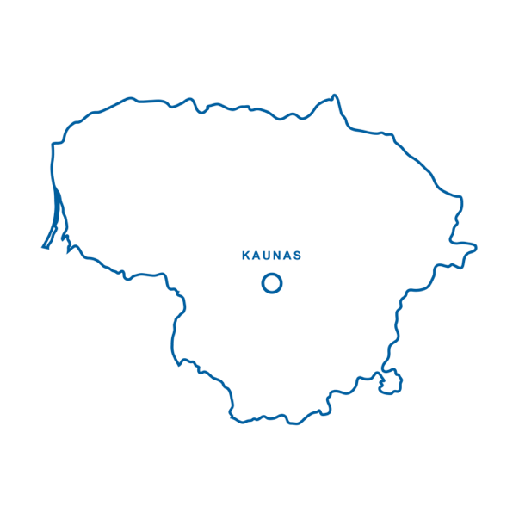
~50,000 students live and study in Kaunas
A short flight (2 to 3 hours) from any European city

Slide 16
THE GAME No. 5
What is the second (unofficial) religion in Kaunas?

Slide 17
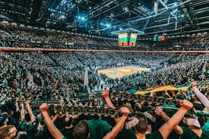

THE GAME No. 5

Slide 18
3
THE UNIVERSIY
International Relations Department

Slide 19
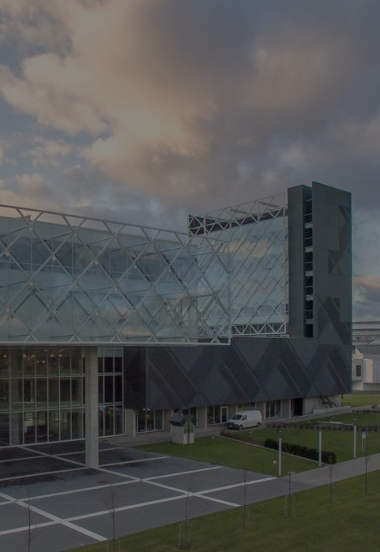
KTU – largest and oldest technological university in Lithuania
One of the largest in the Baltics
Established in 1922
The University

Slide 20
9 Faculties
Chemical Technology
School of Economics and Business
Electrical and Electronics Engineering
Informatics
Mathematics and Natural Sciences
Mechanical Engineering and Design
Social Sciences, Arts and Humanities
Civil Engineering and Architecture
Panevėžys Faculty of Technologies and Business
The University

Slide 21
KTU community
7549
4932
2212
Students
Bachelor students
Master students
The University
1278
333
1072
International Students
PhD students
Academic staff

Slide 22
THE GAME No. 6
Which University is known for:
linkages with business
leadership in scientific research
flexible interdisciplinary study programmes
unforgettable study experience?

Slide 23

THE GAME No. 6

Slide 24
Useful sites to check
lithuania.travel.lt
visit.kaunas.lt
tour.ktu.edu
students.workinlithuania.lt
studyin.lt/about-lithuania/useful-information/

Slide 25
4
THE OFFICE
International Relations Department

Slide 26

INTERNATIONAL RELATIONS DEPARTAMENT
INTERNATIONAL STUDIES OFFICE
Thibaut
Intern
Silvija
Enrolment Manager
Monika
Exchange Programmes Manager
Academic Mobility and Networks Office
Inga
Enrolment Manager
Kabilan
Publicity Projects Coordinator
Giedrius
International Students Manager
Gediminas
International Studies Marketing Coordinator
Audronė
Head of the Office
Notes:
Gal užtenka tik paminėti, kad yra ir kitas skyrius?

Slide 27
5 TIPS FOR YOUR SUCCESSFUL LANDING at KTU
Find the best place to live
Investigate travelling to and around Kaunas options
Get acquainted with local weather and culture, learn few phrases in Lithuanian
Prepare to make the most of your studies
Meet your peers beforehand - take care of your emotional ang physical wellbeing

Slide 28



Contact us!
international@ktu.lt
KTUStudentams
@ktustudentlife
@ktuwanted
@ktuspace
International Relations Department

Slide 29
AČIŪ
International Relations Department

