Slide 1
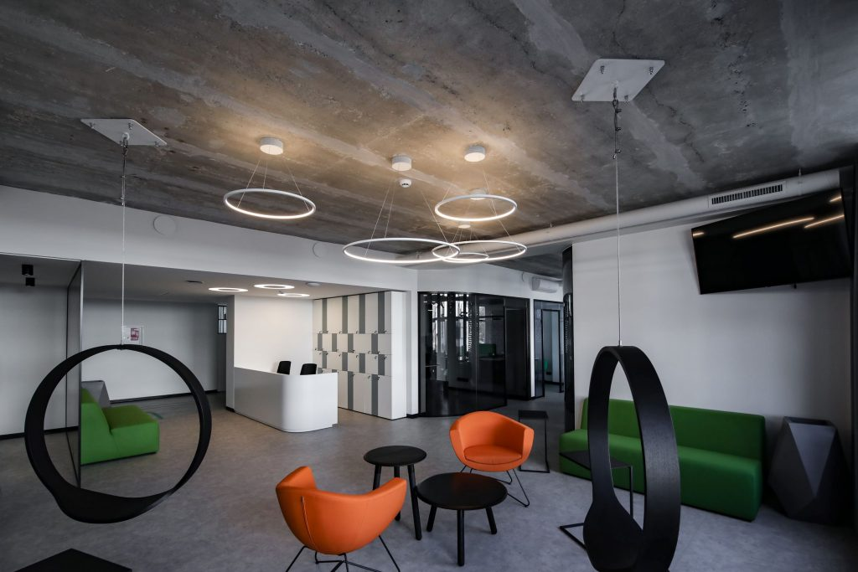
KTU Career and Service Centre

Slide 2
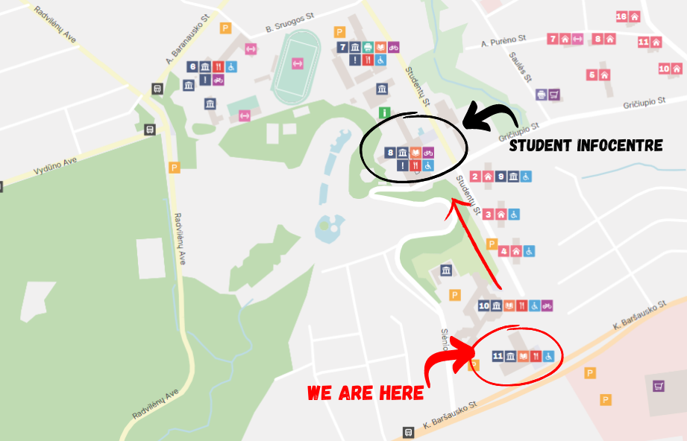
WHERE ARE WE?

Slide 3
WHAT YOU CAN FIND HERE?
PSYCHOLOGICAL SUPPORT
FINANCIAL SUPPORT
ED‘ PROGRAMMES
ACCOMODATION CENTRE
PHD SCHOOL
INTERNATIONAL RELATIONS DEPARTMENT
STUDY CENTRES ARE LOCATED IN EVERY FACULTY SEPARATELY (anything related with studies should be consulted with your Faculty‘s study centre, International Relations Coordinator)

Slide 4
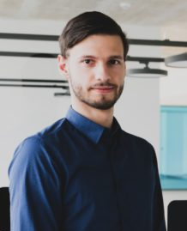
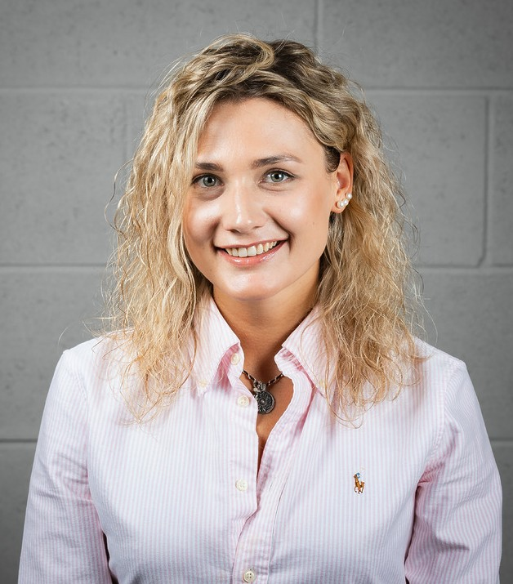
PSYCHOLOGICAL SUPPORT
KTU takes full care of the students’ wellbeing and provides free psychological assistance to students.
Fill in the registration form and you will agree on the time and date of the consultation.
The duration of the consultation is 50 min. During an online consultation, the student must ensure a comfortable environment for the session: he or she must be alone, without other people or additional distractions.
MORE:
students.ktu.edu/wellbeing/
psichologai@ktu.lt
Eimantas Lukoševičius
Psychologist
Viktorija Ivanauskaitė
Psychologist

Slide 5
FINANCIAL SUPPORT
Scholarships for study results and active participation:
• University Talent Scholarship
• Scholarships for students enrolled in the GIFTed Talent Academy
• Scholarships for students enrolled in the specialized programmes of SKILLed FinTech and SKILLed AI
• Sponsor Scholarships
One-time scholarships for active participation:
• One-off incentive scholarship
• One-off targeted scholarship
Financial support provided by the University:
• One-off social scholarship
• Accommodation grants
• Mobility scholarships for bilateral exchange studies
State support
ERASMUS+ financial support:
• Scholarship for partial studies and internships abroad
MORE:
https://students.ktu.edu/finance/

Slide 6
Accommodation grants
KTU students, who have difficult financial or social situation and do not pay more than 138 Eur for a room can apply for a dormitory accommodation grant;
Applied monthly Accommodation Grant for one person at the dormitory is determined by the commission;
Scanned documents have to be submitted in your AIS by the 20th of each month at the latest.
MORE:
students.ktu.edu/finance

Slide 7










ED PROGRAMMES

Slide 8
Talent development programmes
Here you will participate in business/science challenges. During the "Challenge" projects, you will create innovative products and intensively collaborate with representatives from the the business field and other interdisciplinary experts.
Here you will acquire strong competencies needed for a successful career in AI through individually selected additional modules, collaborations with top researchers and business representatives.

Slide 9
300 EUR monthly scholarship from the second study semester;
Option to select additional modules or enhanced level lectures.
Comprehensive education activities.
One-on-one meetings with mentors and career planning specialists.
An individual portfolio of competencies and personal recommendations.
Opportunity for collaborations with top-level professionals in the fields of science/business.
Active community, new friends and events.
Interested in joining?
The deadline is SEPTEMBER 4, 23:59. Submit your application via AIS, under the COMPETITIONS section.
MORE:
students.ktu.edu/ed-programmes/

Slide 10
Every student can have a mentor or become a mentor themselves – don't miss this opportunity!
The GUIDed consists of five programmes: Introduction, School, Academic, Career Mentoring, and Tutoring.
All mentoring programmes provide you with the chance to have your personal teacher, role model or friend at the University.
MORE:
students.ktu.edu/ed-programmes/guided/

Slide 11
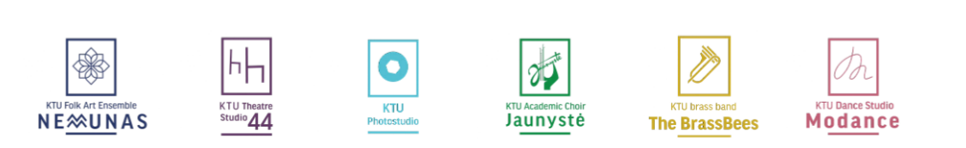
The INSPIRed programme features 6 art societies.
Led by renowned professionals in the country, these collectives will help you expand your possibilities and discover new abilities. Here, you will have a meaningful leisure time and improve your knowledge in the chosen field as well as have the opportunity to overcome stage fright, enhance public speaking skills, develop self-confidence, and forge lifelong friendships.
MORE:
students.ktu.edu/ed-programmes/inspired/

Slide 12

The UNITed programme brings together 19 student organisations and facilitates your comprehensive personal development by allowing you to acquire additional competencies and skills.
Currently, you can choose from a wide range of organisational activities:
enhancing the applicability of studies;
promoting science, organising international projects;
developing various specific skills;
engaging in active leisure;
promoting citizenship and many others.
MORE:
students.ktu.edu/ed-programmes/united/

Slide 13
With this programme you can start shaping your career path.
Participate in the events and seminars that will help you better understand the latest labour market trends, form a more versatile vision of your career, and develop personal competencies.
Register for a personal career consultation in the AIS, a career planning consultant will help you answer many career-related questions, for example, how to prepare a resume.
Follow the ads on the WANTed internship and job platform and don't miss the opportunity to gain more experience.
MORE:
students.ktu.edu/ed-programmes/wanted/

Slide 14

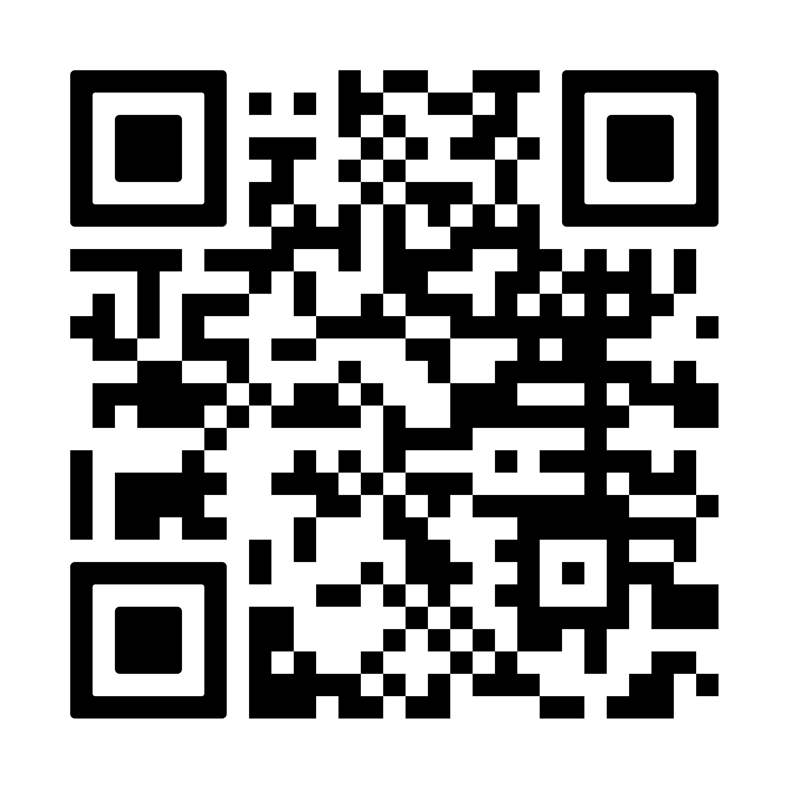

Slide 15

The entire KTU community has free access to the sports club at all times, which includes a free weights zone, boxing and TRX belt gyms, cardio and strength machines. An online reservation is required for those wishing to visit the gym.
We invite you to register and actively spend your free time!
MORE: sports.ktu.edu

Slide 16
BE UPDATED
FACEBOOK
KTU international students
KTU Studentams
INSTAGRAM
@ktustudentlife
@ktuwanted
@ktuspace
Newsletter:
Every other Wednesday starting from today!
Don‘t forget to check information at:
KTU AIS
Office 365 (intranet)
Your academic e-mail

