Slide 1
MUST KNOW
Full-time degree students
Giedrius Jankauskas
International Student Services Specialist

Slide 2
Overview
In the following slides, we will look at how to apply for a Temporary Residence Certificates for EU citizens and Temporary Residence Permits (TRP) for non-EU citizens, as well as the procedure for renewing your TRP.
We will also cover possible reasons for the termination of a TRP and other important information related to your TRP.
At the end, we will look at how to obtain a student ID and the benefits it provides.

Slide 3




The fee is 10.00 EUR (can be paid at the place of service).

Slide 4
Application procedure (I)
Apply through the Lithuanian Migration Information System (MIGRIS): https://www.migracija.lt
Together with the application, you need to submit:
A valid travel document (passport).
Confirmation of studies / acceptance letter from the university
A bank statement certifying sufficient funds for living in Lithuania (minimum: 221 EUR per month or 2652 EUR per year; assessed individually depending on personal situation)
Valid health insurance (e.g., European Health Insurance Card)

Slide 5
Application procedure (II)
After the application is submitted, you will be able to book an appointment at the Migration Department and submit the required hard copies of your documents.
Once the certificate is issued, you will receive a notification at your indicated e-mail address. You can then either:
Go to the Migration Department to collect the document, or
Request delivery within Lithuania via courier.

Slide 6




•
•
If you are NON-EU citizen and came to Lithuania on visa-free basis, you can legally stay in Lithuania for 90 days while applying for Temporary Residence Permit (TRP) in Lithuania. The application for TRP needs to be made asap.
If you are NON-EU citizen and came to Lithuania with the TRP, it is issued for two years or until estimated graduation date. You can extend the validity of your TRP by applying through MIGRIS system (more info on TRP renewals in the following slides).

Slide 7
Application procedure (I)
Apply for a Mediation Letter:
Order via the Academic Information System (AIS), in the Certificates ordering section → then choose option: „for legal status“ → select “Mediation letter for issuing of Temporary Residence Permit (TRP)”.
The letter is issued within 3–5 working days.
Once prepared, the reference number will be sent to your …@ktu.edu email.
Only the reference number is required — you do not need the physical document.

Slide 8
Application procedure (II)
Apply through the Lithuanian Migration Information System (MIGRIS): https://www.migracija.lt. You will also need to submit:
Valid travel document (passport)
Proof of health insurance (such as Gjensidige, BTA or others)
Bank statement showing a sufficient amount of funds (not less than 7300.00 EUR for a year) If you hold an overseas bank account, the document must be presented in English; Please note that the bank statement must include transaction history for the past 6 months. If the bank account is in the name of a relative, you must also provide a notarized letter of financial support (in English), signed before a public notary.
Declaration of place of residence. More info on this in the following slides.
Police Clearance Certificate (PCC) / non-criminal record.

Slide 9
Application procedure (III)
Police Clearance Certificate (PCC)
Must be legalized or certified with an Apostille, and written in English or officially translated.
Has not been expired.
If your country is not part of the Hague Convention and documents cannot be certified with an Apostille, double legalization is required:
  The document must be legalized by the Ministry of Foreign Affairs of the country where it was issued.
  After arriving in Lithuania, it must be legalized again at the Ministry of Foreign Affairs of Lithuania.
  In some cases additional legalization is needed. For more specific details please visit the Ministry of Foreign Affairs website.

Slide 10

Application procedure (IV)
After the application is submitted, you will be able to book an appointment at the Migration Department and submit the required hard copies of your documents.
Once the certificate is issued, you will receive a notification at your indicated e-mail address. You can then either:
Go to the Migration Department to collect the document, or
Request delivery within Lithuania via courier.
https://keliauk.urm.lt/en/consular-services/legalisation

Slide 11
Application deadlines and procedure timeframes
General order (160 EUR)
Please apply no later than 2 months before current TRP expires. Decision process takes usually up to 2 months.
Urgent order (320 EUR)
Please apply no later than 1 month before current TRP expires.
Decision process takes usually up to 1 month.

Slide 12
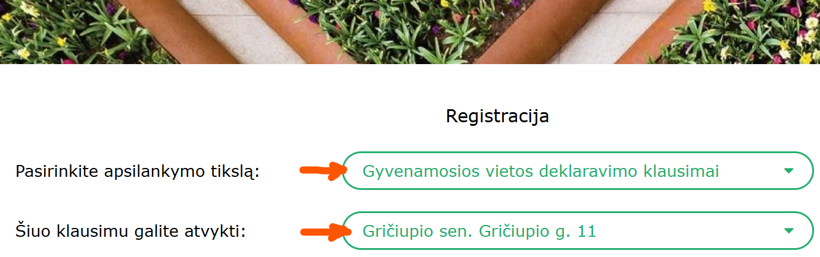
select as per below:
Declaring your place of residence (I)
You must declare your place of residence within 1 month from arrival.
Step 1 – please contact the dormitory group (dormitory@ktu.lt) regarding the certificate of living place. It’s a document stating that you live in the dormitory.
Step 2 - after you receive a certificate of living place, you are also required to declare your address at the Eldership (lt: seniūnija). So if you are residing in on of KTU dormitories – please contact the Gričiupis Eldership (address: Gričiupio g. 11, Kaunas) by making an appointment prior. The appointment can be done via phone +370 374 55017 or online https://registracija.kaunas.lt , please select as per below. During the appointment, you will have to provide the certificate of living place issued by dormitories office. Eldership will provide you the declaration of living place.
During the appointment, you will have to provide the certificate of living place issued by dormitories office. Eldership will provide you the declaration of living place.

Slide 13
select as per below:
Declaring your place of residence (II)
If you don’t live in dormitory, you can ask your landlord to give you the declaration of living place. If he agrees to do that, you just have to provide this declaration to the Migration department. If landlord is not giving you the declaration, you can contact dormitories office dormitory@ktu.lt for a document confirming that you can declare your living place in dormitories address even if you don’t live in the dormitory (this is payable service).

Slide 14
select as per below:
Updating personal code (I)
Once you receive your TRP, you are required to update your temporary personal code (which consists of both digits and letters) to the one indicated on your TRP (digits only). Please submit your request to update the personal code through AIS.

Slide 15
select as per below:
Renewing your TRP (I)
General order (160 EUR) – decision is made usually within 2 months
Please apply no earlier than 4 months and no later than 2 months before your current TRP expiration day.
Urgent order (320 EUR) – decision is made usually within 1 month
Please apply no earlier than 4 months and no later than 1 month before your current TRP expiration day.
TRP is issued for the maximum period of two years (three years for PhD students). It can be extended after but cannot exceed the expected graduation date. For final year students another 6 months to stay and work in country is granted.

Slide 16
select as per below:
Renewing your TRP (II)
As per Migration Department requirements, to renew your TRP the student must have completed no less than 40 academic credits in the previous study year. If you have fewer credits and cannot provide a valid reason (e.g., illness, the death of a relative) with supporting documents, the Migration Department may reject your application.

Slide 17
Another Important Information (I)
Can my TRP be cancelled (revoked) ?
If you decide to take the academic leave (including health related reasons) or suspend or terminate your studies, your TRP will be cancelled and you would have to leave the country within 14 days. No exceptions given.

Slide 18
Another Important Information (II)
Can I have an employment while studying?
Yes, you can be employed full-time, as long as it does not interfere with your studies.

Slide 19
Another Important Information (III)
Can I bring my family members?
Family members (spouse and children) can be brought by master and PhD students only. The university does not mediate in this process.

Slide 20
Another Important Information (IV)
After my studies are completed, can I get a job search visa?
When you finish your studies you may apply for a one-year job search visa. Please note, university does not mediate in this process. More info here.

Slide 21
Student ID cards
You have two Student ID options: you may choose one or both:
1. Lithuanian Student Card (LSC). When ordering LSC it is recommended to include European Student Card (ESC) add-on at no extra cost, which alow to access discounts for student across whole EU. More info here: https://www.lsp.lt/en
2. International Student Identity Card (ISIC). Works in a similar way as the above, but you can access discounts for students not just in Lithuania or EU, but almost anywhere across the globe (over 130 countries in total). More info here: https://www.isic.lt/en

Slide 22
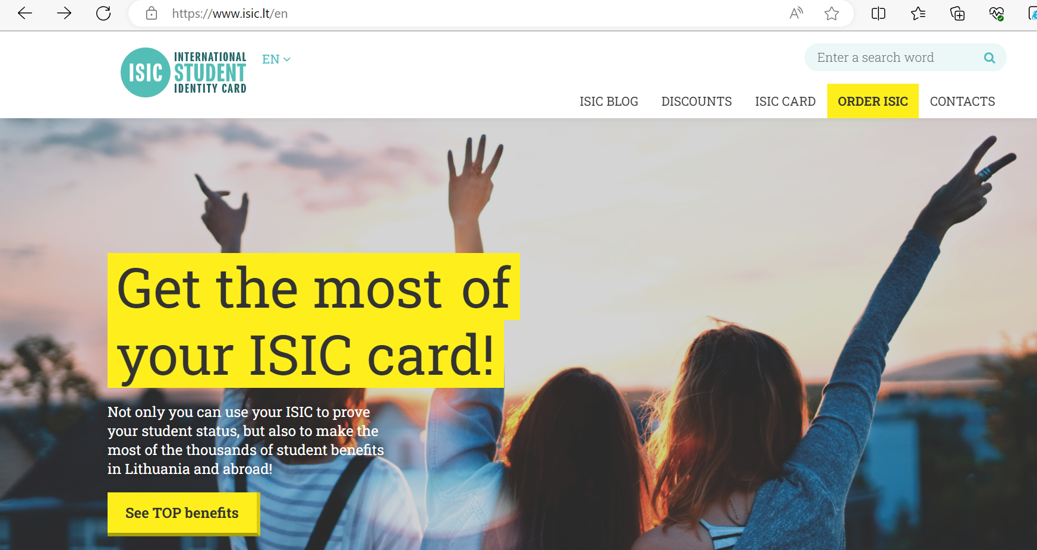
ISIC card
www.isic.lt/en - ORDER ISIC

Slide 23
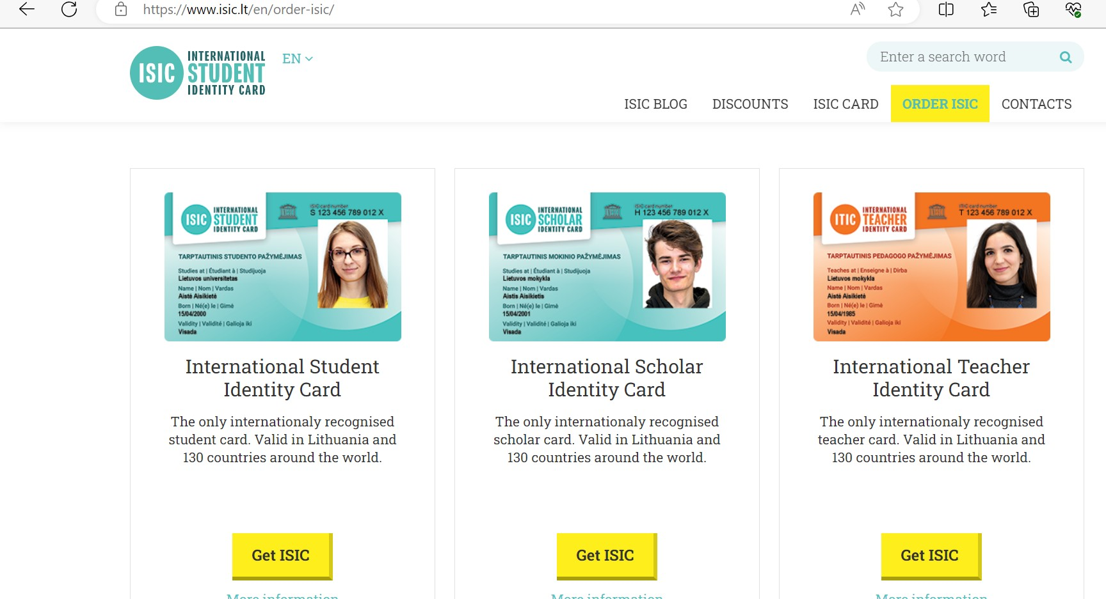
2) International student identity card

Slide 24
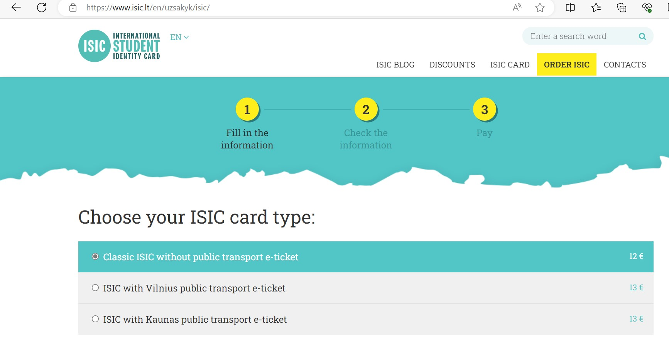
3) Fill in the information, Check the information, Pay

Slide 25

For any migration related questions:
Giedrius Jankauskas
Email: giedrius.Jankauskas@ktu.lt
Tel: +370 676 422 76
For anything else:
Email: international@ktu.lt
Or visit our International Studies Office
at the Student Infocenter, Studentų st. 50, Kaunas
Mon-Thu 13:00 - 17:00
Fri 13:00 - 15:45

